Slide 1

Phase Diagrams
Dr. J. Venkatramani
219-B
venkatramani@iiitdm.ac.in

Slide 2
Terminology
Solute
Solvent
Component
System

Slide 3
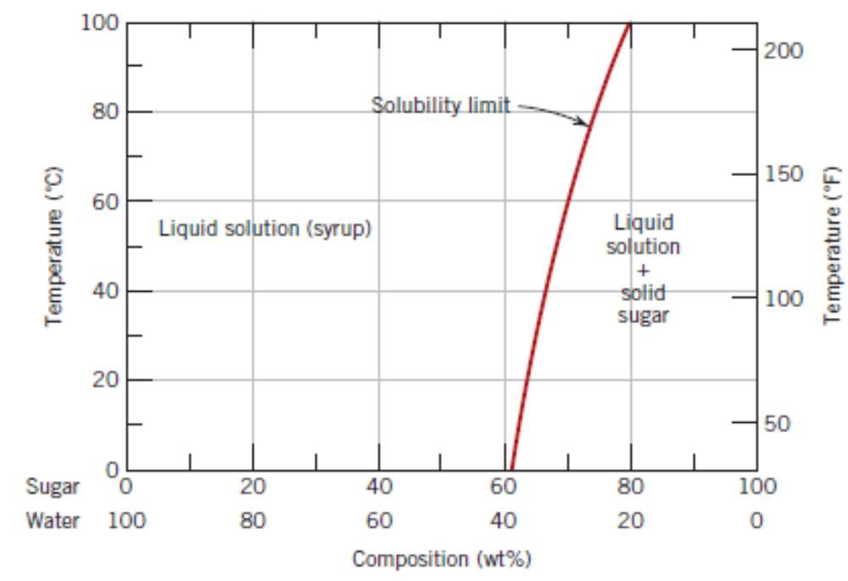
Solubility Limit
Water continues to dissolve sugar till a certain limit called solubility limit.
Beyond this limit, sugar does not dissolve and thus, remain as a separate substance within the sugar–water solution.
Solubility is temperature dependent.
The solubility of sugar (C₁₂H₂₂O₁₁) in a sugar–water syrup.

Slide 4
Definition of a phase
Homogeneous portion of a system that has uniform physical and chemical characteristics.
Every pure material is considered to be a single phase system.
When two phases exist in a system, they can differ in either physical properties or in chemical properties or in both.
Examples: Sugar–Water solution + Solid sugar; Ice + Water
Existence of a substance in two or more polymorphic forms, like FCC, BCC is possible. Then, each of these structures within the substance is a phase.
Single phase systems are termed “homogeneous”, while the ones with more than one phase are termed “mixtures” or “heterogeneous”. Alloys, ceramic, polymeric and composites systems are heterogeneous.

Slide 5
Phase Equilibria
Free Energy: F = E–TS, where, E is the internal energy of the system, T the absolute temperature and S, the entropy.
A system is said to be in equilibrium when its free energy is at a minimum for a given pressure, temperature and composition.
Phase equilibrium refers to the equilibrium of systems with more than one phases. Look at the figure showing sugar–water solution + solid sugar system at different temperatures and compositions.
Phase equilibrium is relevant even in systems having only solid phases.
Non–equilibrium or metastable states exist in solid phase systems.

Slide 6
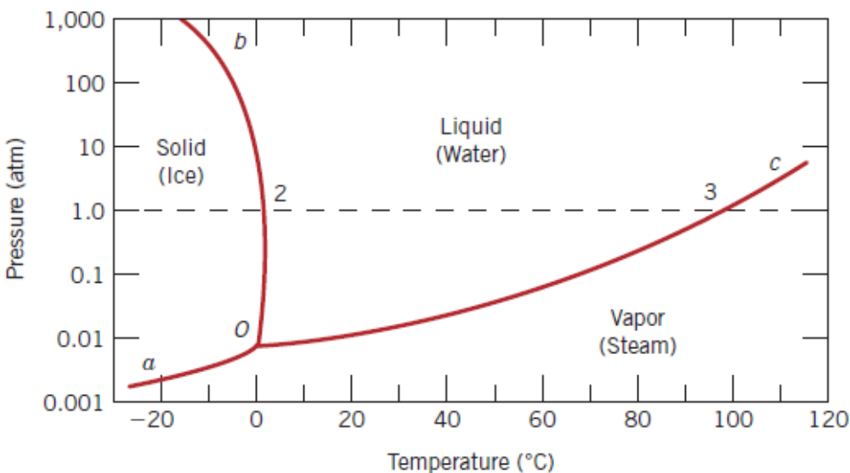
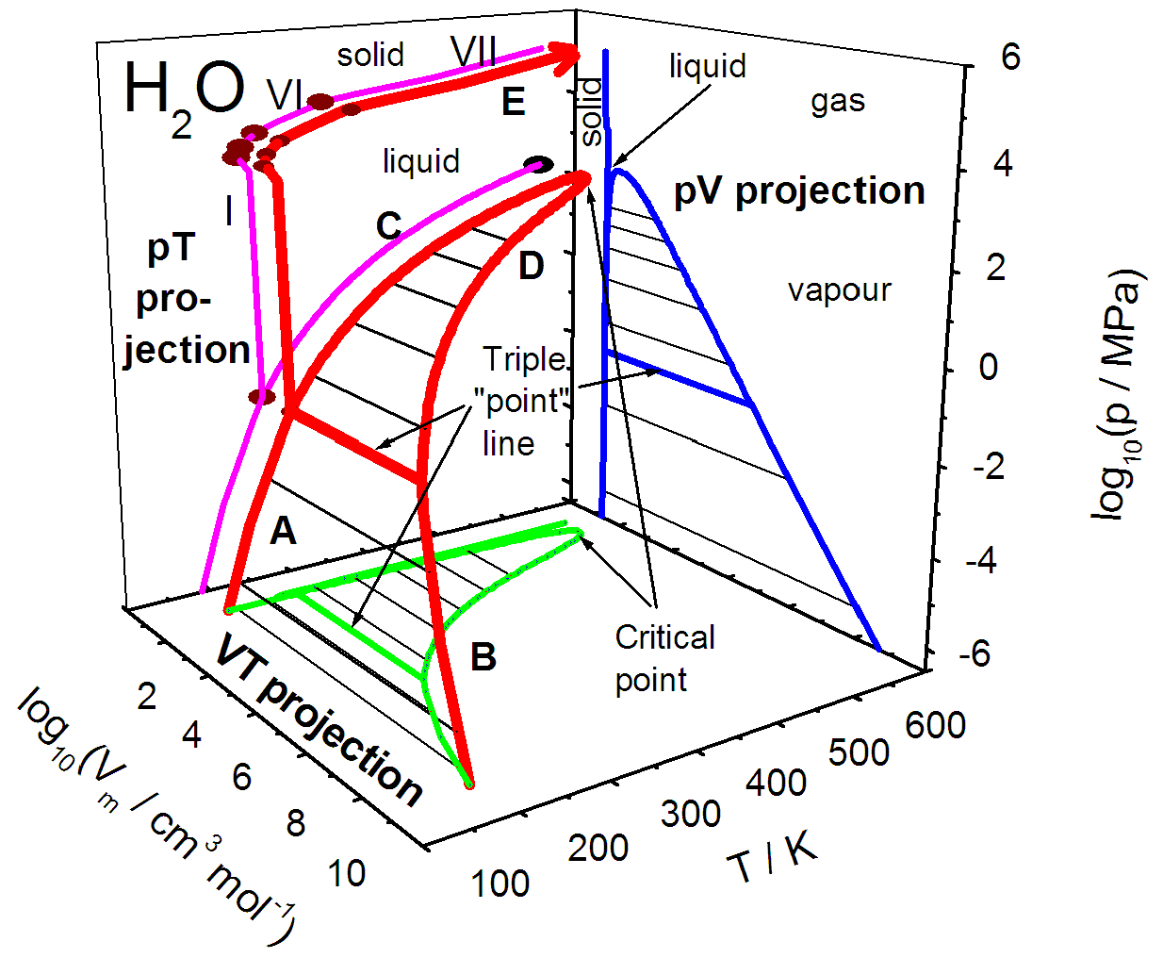
One Component Phase Diagrams (Unary Phase Diagrams)
Phase diagram of a pure substance. Only pressure and temperature are the variables.
Triple point.
Is there any other variable that the phase diagram of a pure substance will depend on?

Slide 7
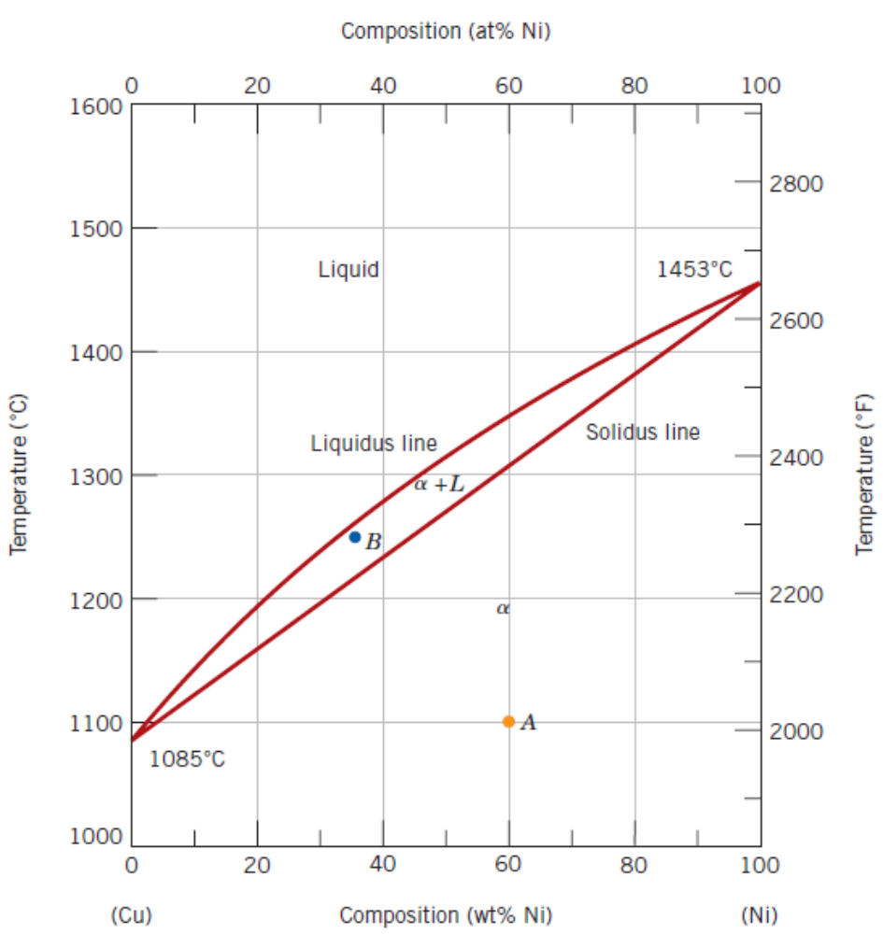
Binary Phase Diagrams
Temperature and composition are variables. Pressure is held constant (normally at 1 atm).
Cu – Ni System: an isomorphous system (no solubility limit).
Complete solubility below 1080⁰C. They have same crystal structure (FCC), nearly identical atomic radii and electronegativities and similar valences – which are all requirements for substitutional type of defects.
Metallic solid solutions are commonly designated by lowercase Greek letters α, β, γ etc.
The phase boundary separating (α + L) and L is called liquidus. The one separating (α + L) and α is called Solidus.
The intersection points of the these boundaries are the respective melting points.

Slide 8
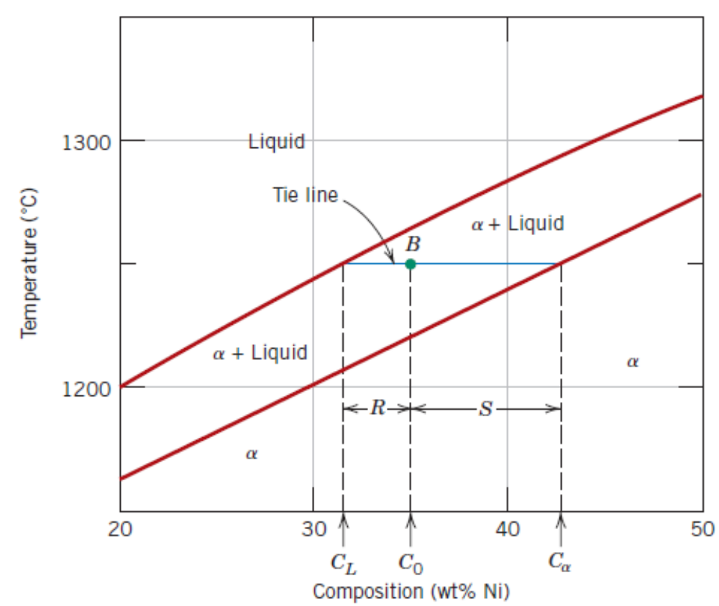
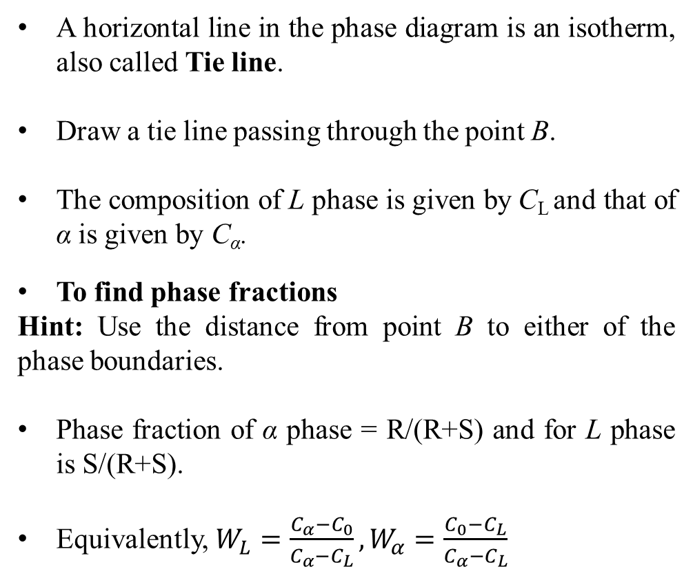
Binary Phase Diagrams – Interpretation
A horizontal line in the phase diagram is an isotherm, also called Tie line.
Draw a tie line passing through the point B.
The composition of L phase is given by C_{L} and that of α is given by C_{α}.
To find phase fractions
Hint: Use the distance from point B to either of the phase boundaries.
Phase fraction of α phase = R/(R+S) and for L phase is S/(R+S).
Equivalently, $W_{L}=\frac{C_{α}−C_{0}}{C_{α}−C_{L}},W_{α}=\frac{C_{0}−C_{L}}{C_{α}−C_{L}}$

Slide 9
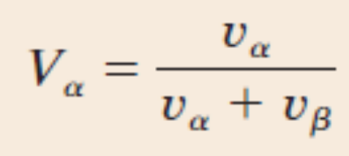
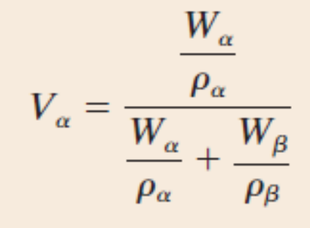
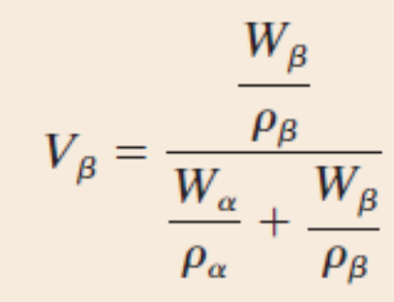
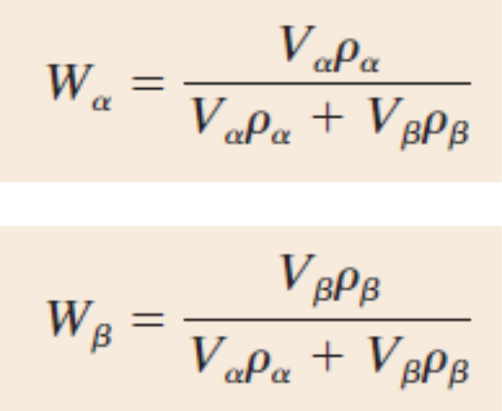
Binary Phase Diagrams – Interpretation
For multi–phase alloys (more than two), volume fractions are preferred.

Slide 10
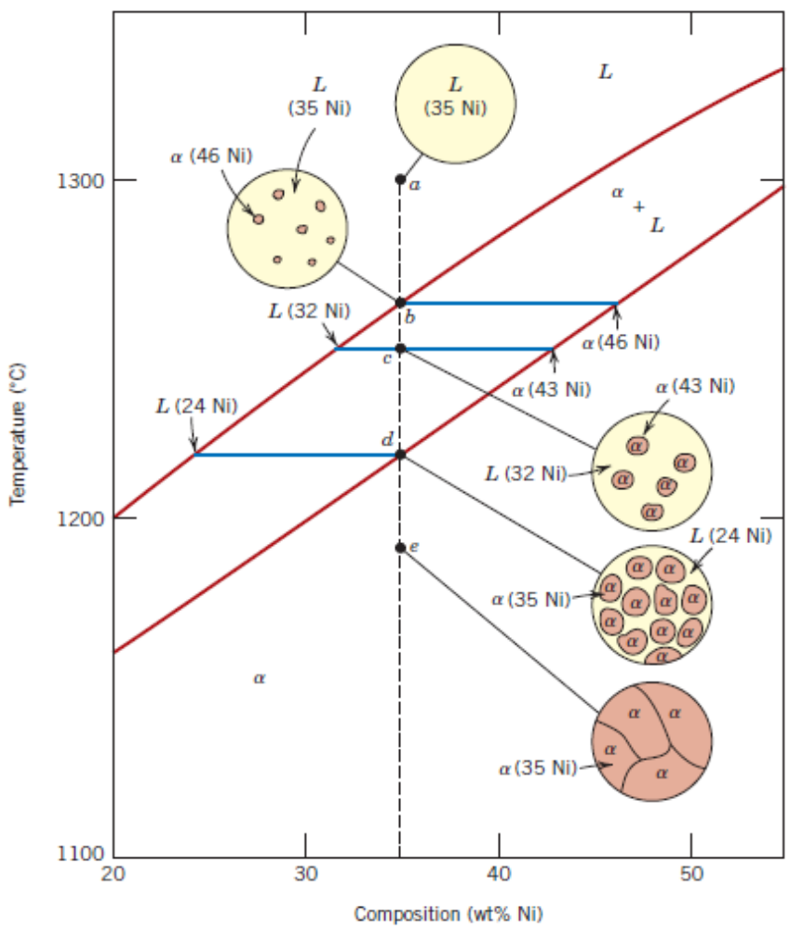
Development of Microstructure – Equilibrium Cooling

Slide 11
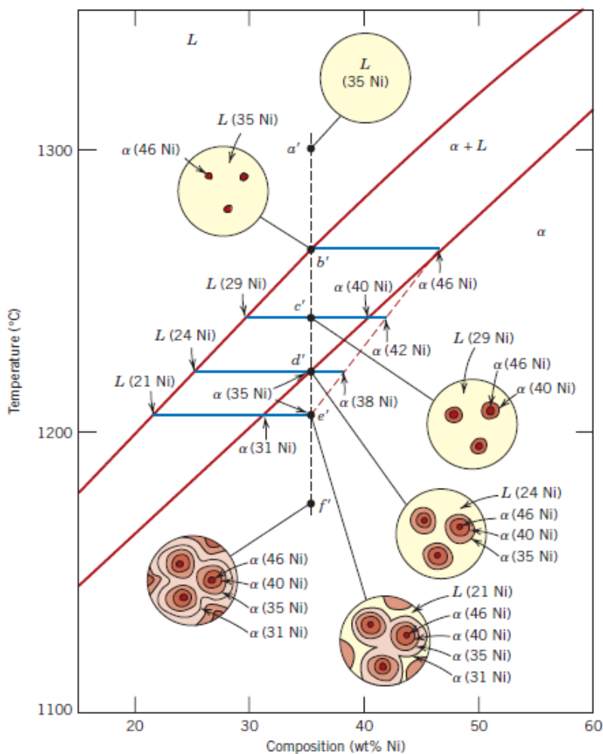
Development of Microstructure – Nonequilibrium Cooling

Slide 12
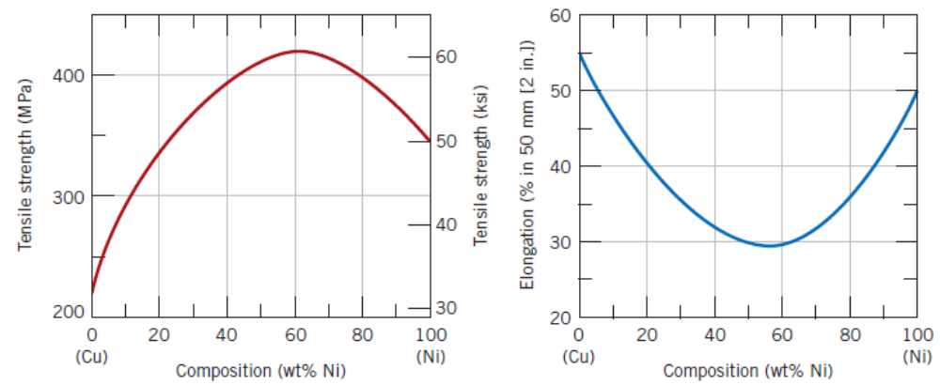
Mechanical Properties of Isomorphous Alloys

Slide 13
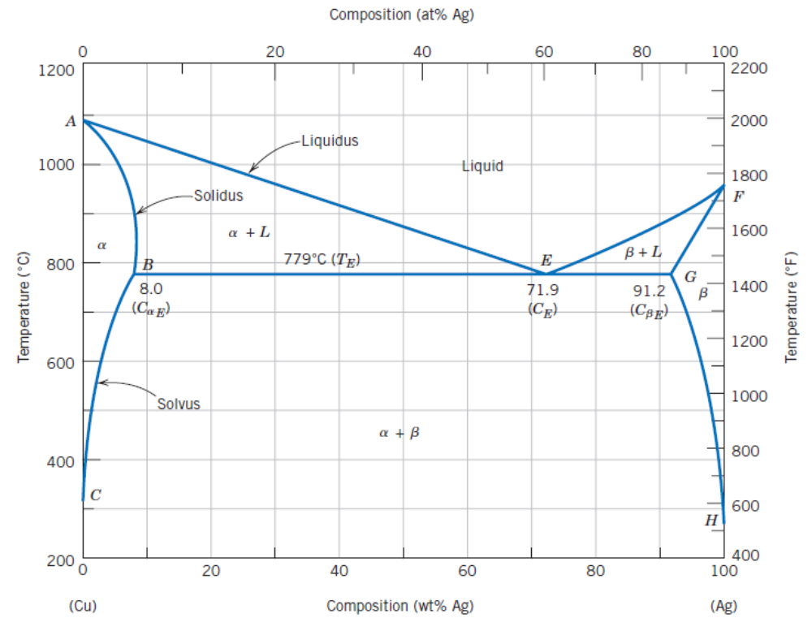
Binary Eutectic Systems – Cu + Ag
Solubility limit
Solidus
Liquidus
Solvus
Melting temperature
Cooling and heating
Eutectic Reaction
Eutectic Isotherm
Eutectic system

Slide 14
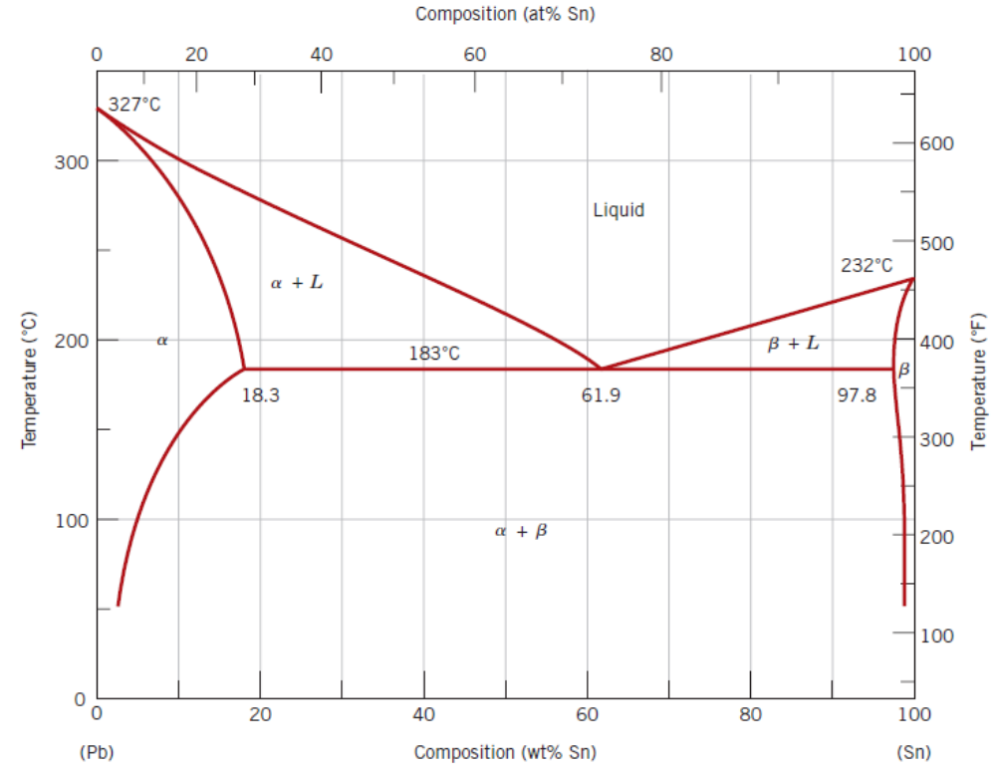
Binary Eutectic Systems – Pb + Sn
Solubility limit
Solidus
Liquidus
Solvus
Melting temperature
Cooling and heating
Eutectic Reaction
Eutectic Isotherm
Eutectic system

Slide 15
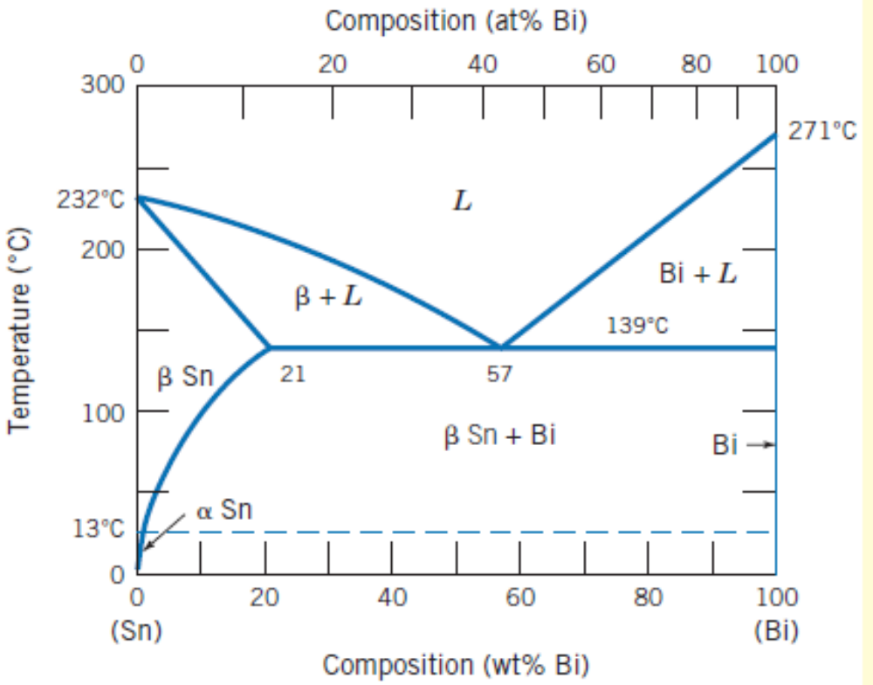
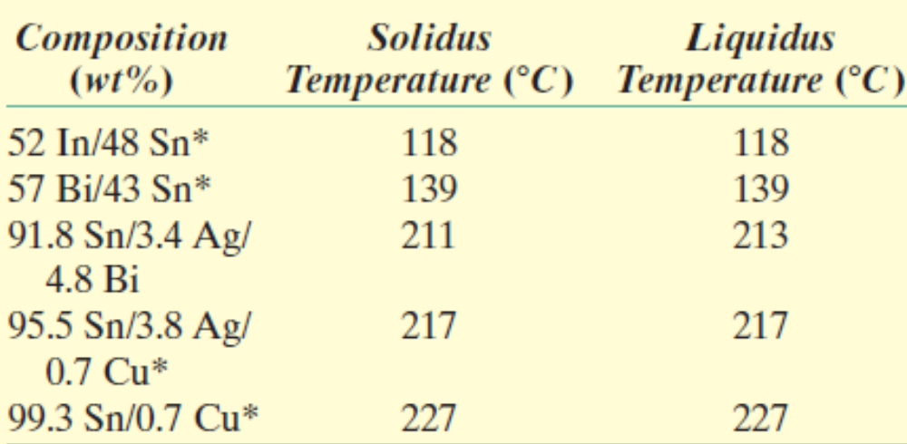
Lead–free solders – Sn + Bi
Ternary alloys as lead–free solders.
Various alloy compositions for lead–free solders.
* Stands for eutectic systems.

Slide 16
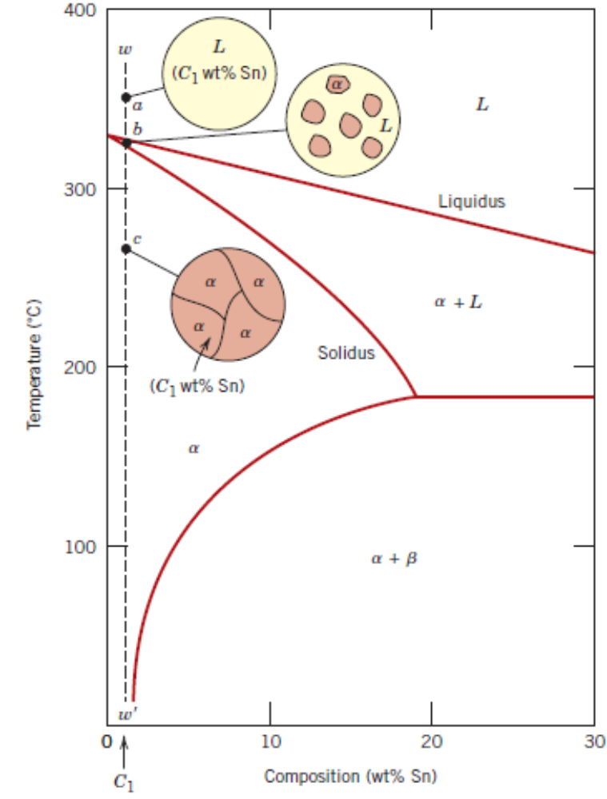
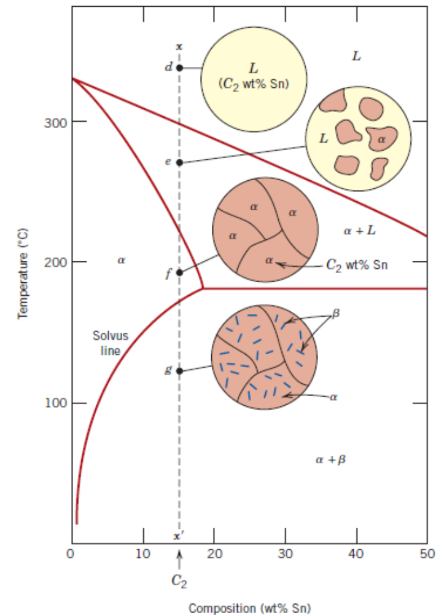
Microstructure in Eutectic Alloys

Slide 17
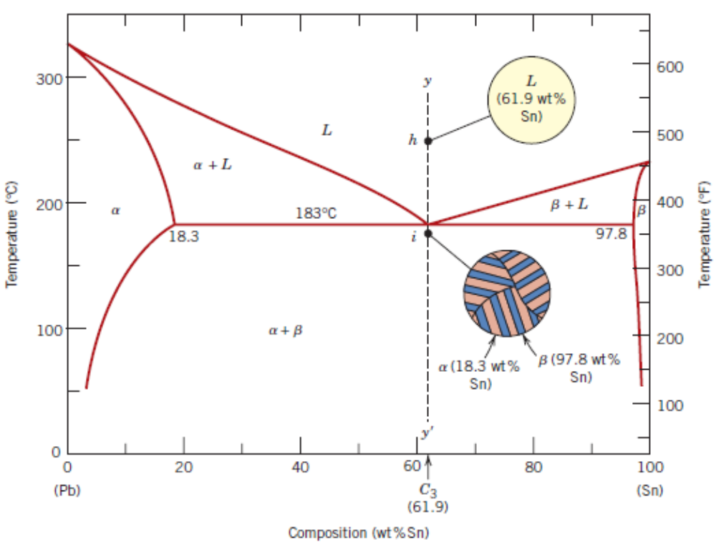

Microstructure in Eutectic Alloys
Dark layers are of α–phase and bright layers are of β–phase.

Slide 18
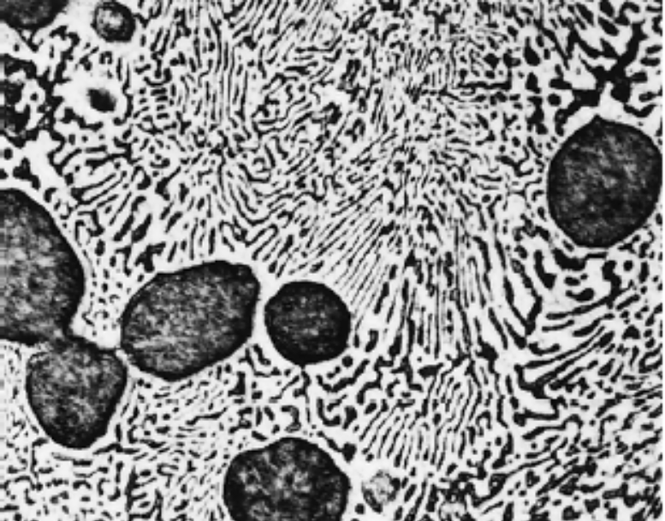
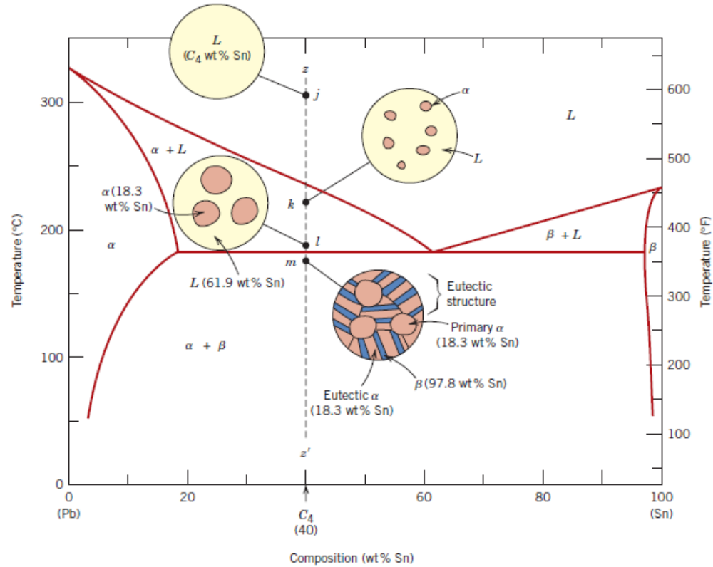
Microstructure in Eutectic Alloys

Slide 19
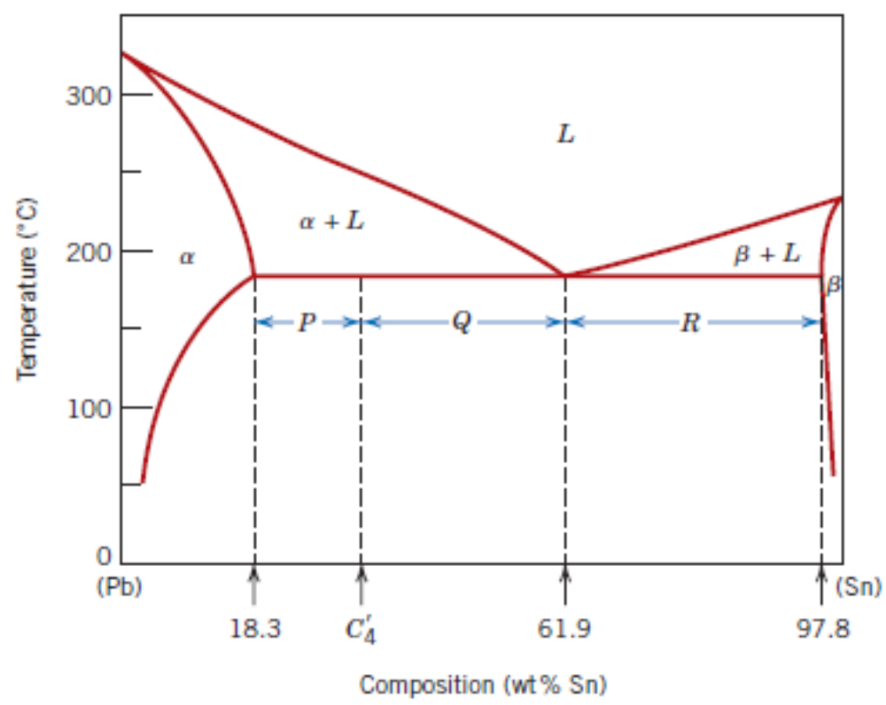
Microstructure in Eutectic Alloys – Phase Fractions

Slide 20
Binary Eutectic Systems – Pb + Sn
Compute all the phase fractions for a 40% tin and 60% Pb alloy at a temperature just below 183⁰ C.

Slide 21
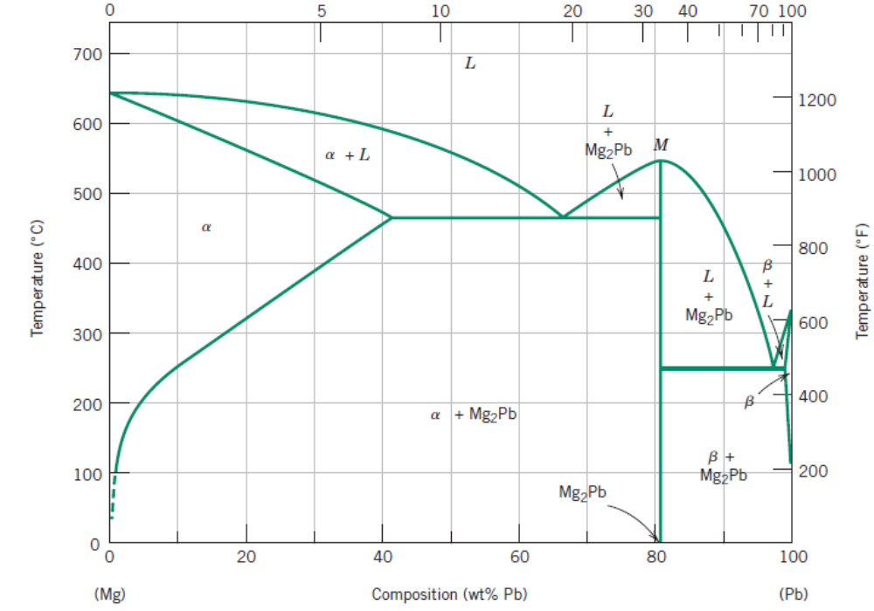
Equilibrium Diagrams Having Intermediate Phases or Compounds

Slide 22
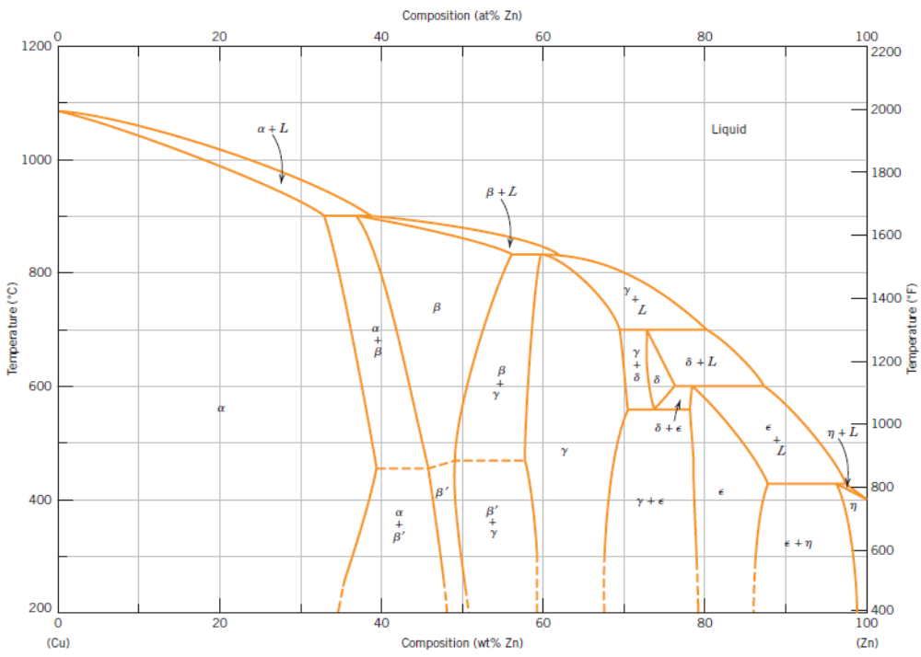
Equilibrium Diagrams Having Intermediate Phases or Compounds

Slide 23
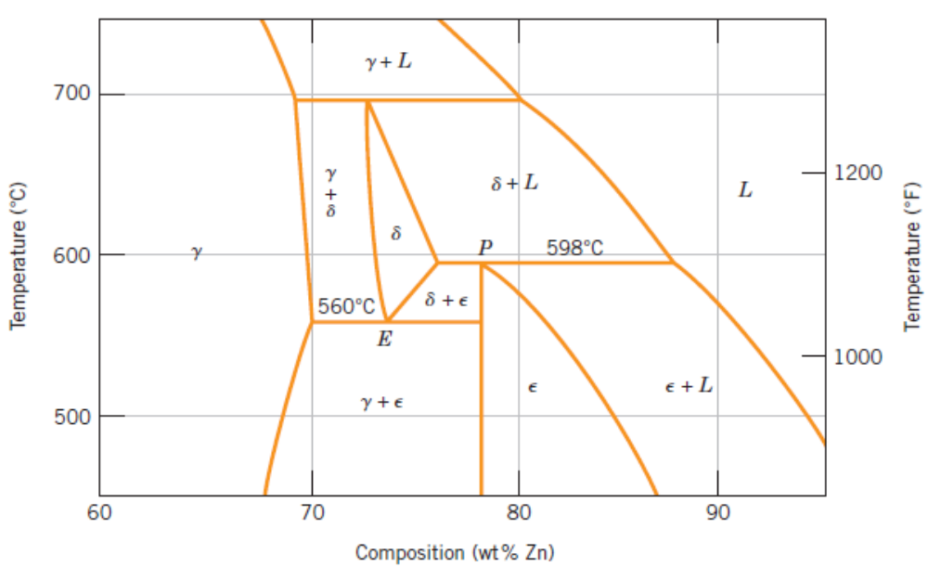
Eutectoid and Peritectic Reactions

Slide 24
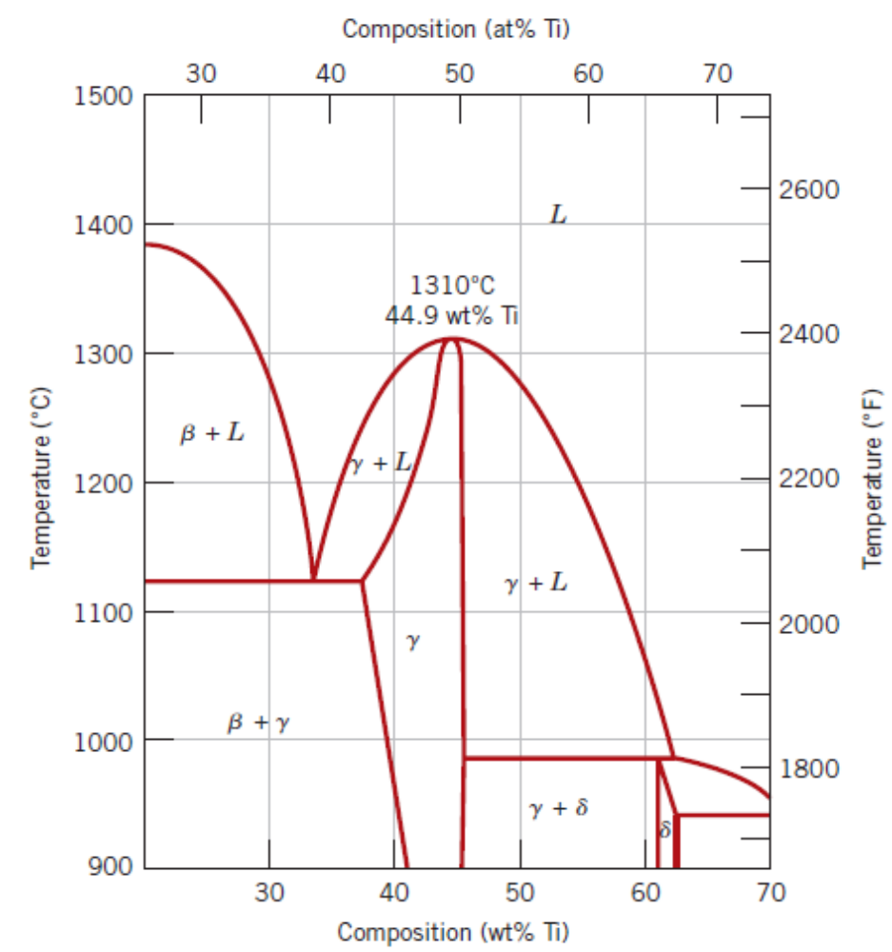
Congruent Phase Transformations
Ni–Ti system

Slide 25
Gibbs Phase Rule
P + F = C + N
P → Number of phases in the system F → Number of degrees of freedom
C → Number of components N → Number of non–compositional variables

Slide 26
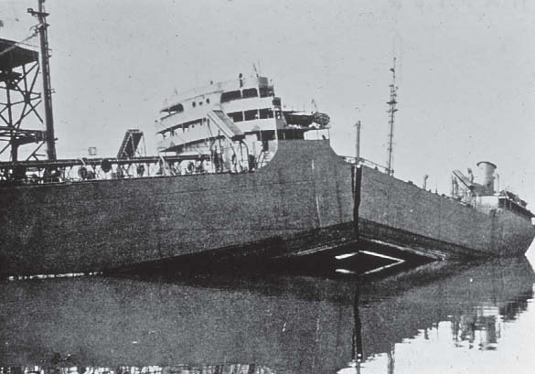
Failure of Liberty Ships

Slide 27
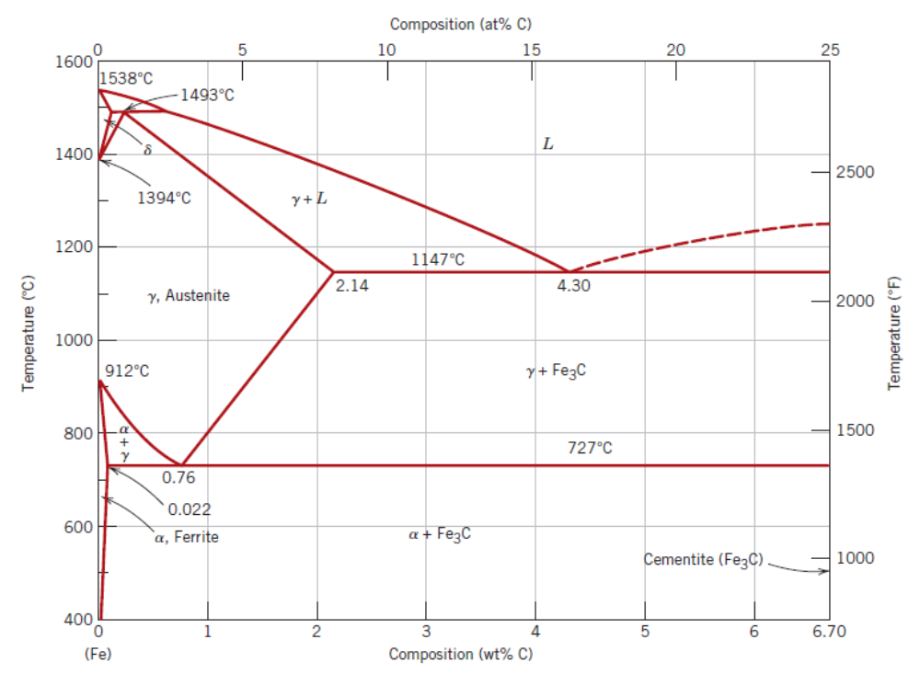
Iron – Carbon System
Fe – Fe₃C

Slide 28
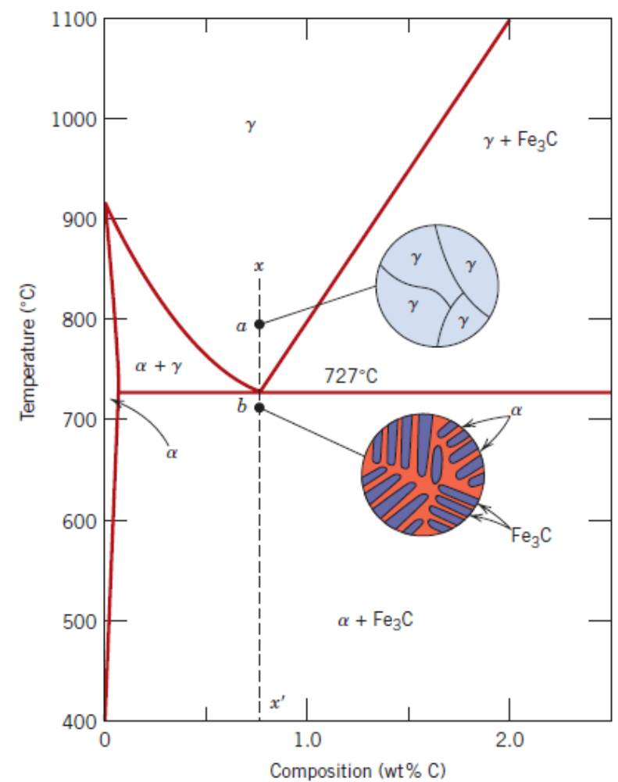
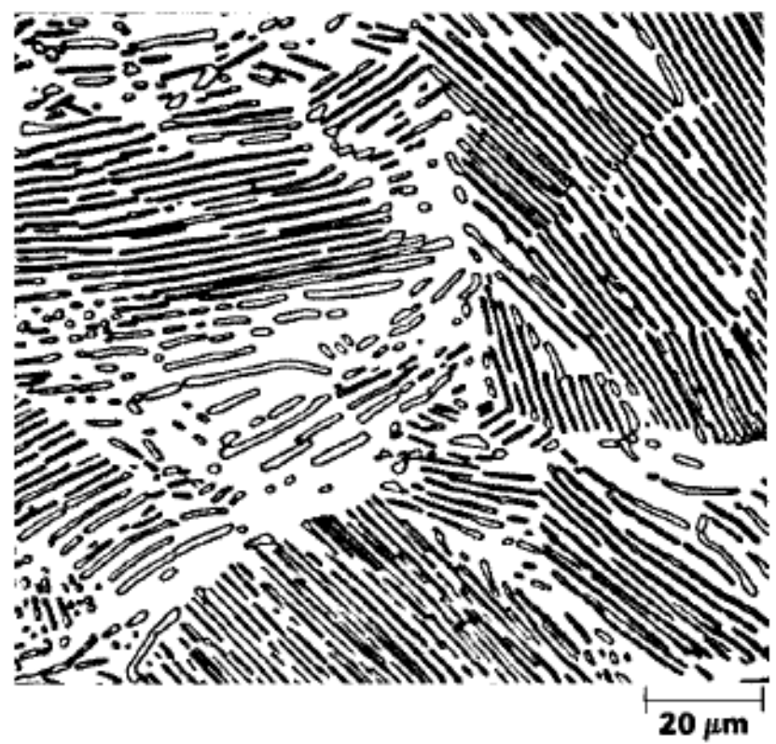
Microstructure evolution in Fe – Fe₃C systems
Pearlite
The darker layers are of Fe₃C and the lighter ones are of α

Slide 29
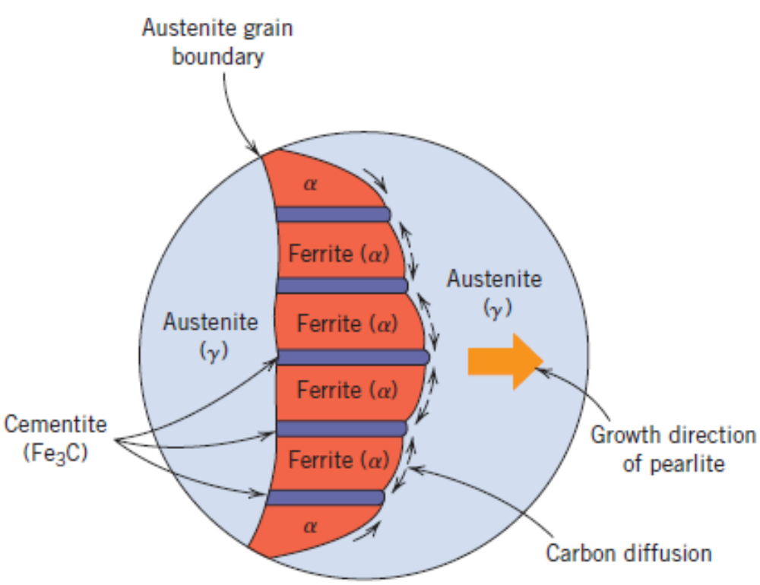
Microstructure evolution in Fe – Fe₃C systems
Pearlite
The darker layers are of Fe₃C and the lighter ones are of α

Slide 30
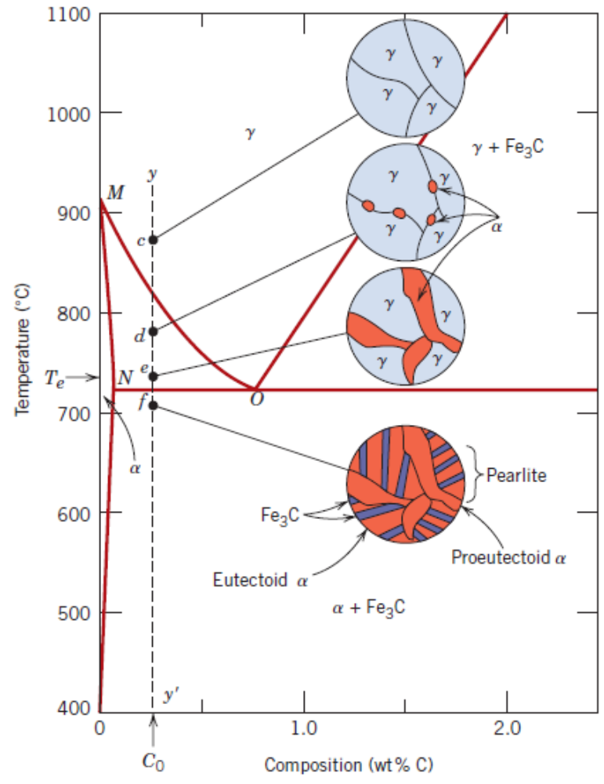
Hypoeutectoid alloys
Final structure consists of pro–eutectoid and eutectoid ferrite micro–constituents.
γ → α + γ → α + pearlite
α phase will start forming along γ grain boundaries.

Slide 31
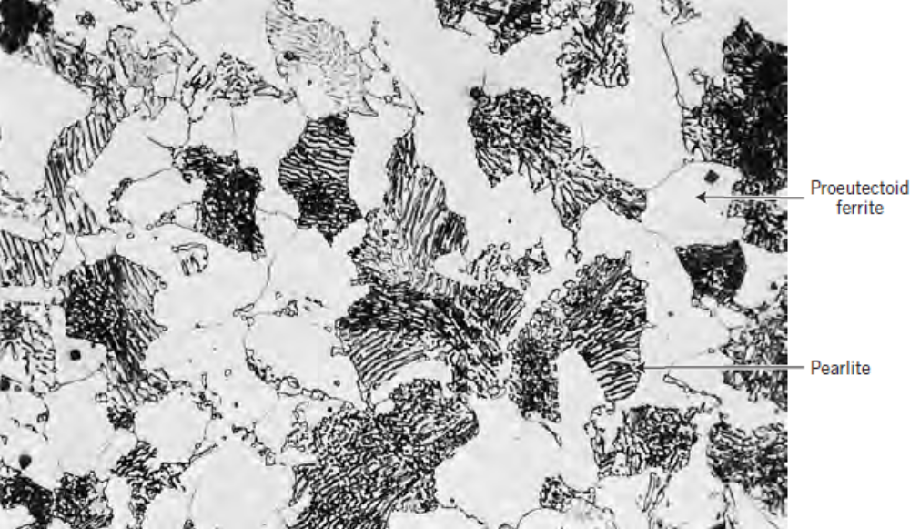
Hypoeutectoid alloys
Final structure consists of pro–eutectoid and eutectoid ferrite micro–constituents.

Slide 32
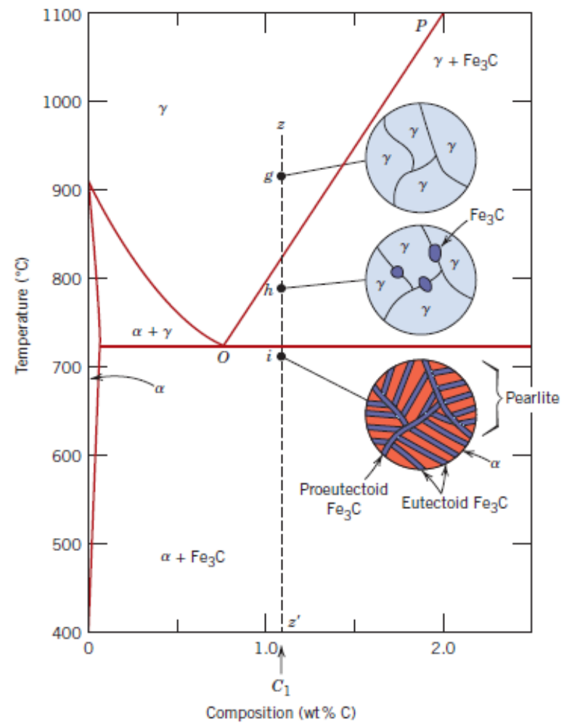
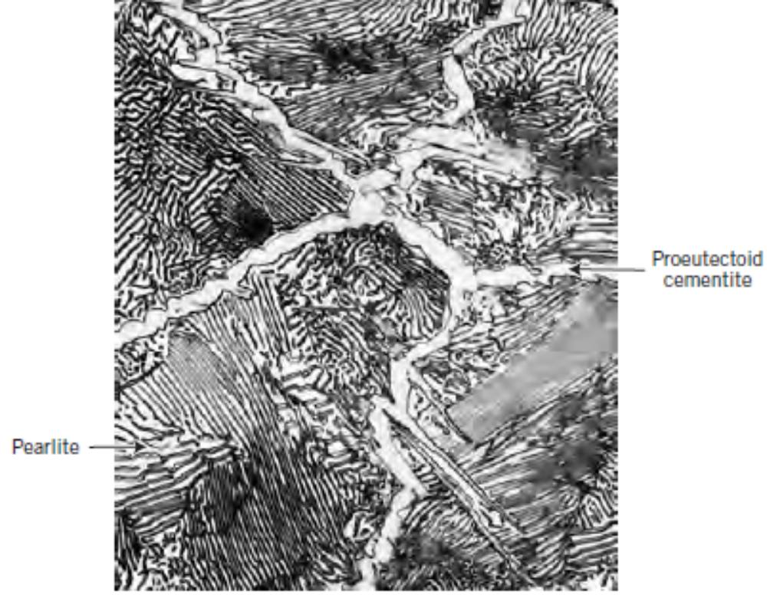
Hypereutectoid alloys
Final structure consists of pro–eutectoid and eutectoid cementite (Fe₃C) micro–constituents.

Slide 33
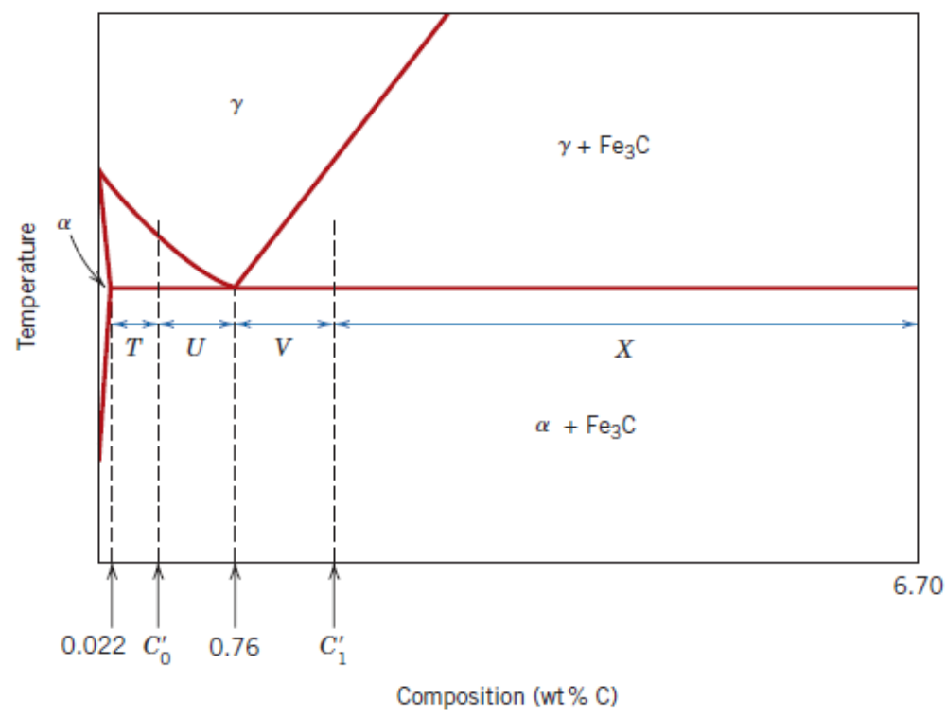
Finding compositions and phase fractions

Slide 34
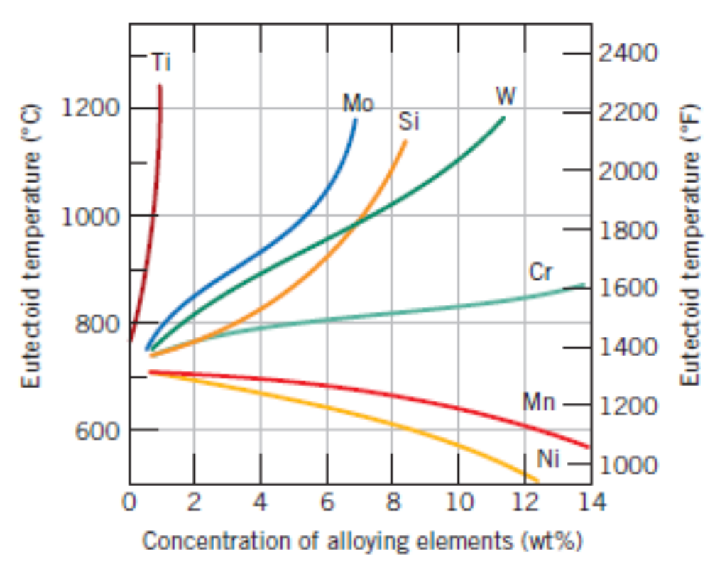
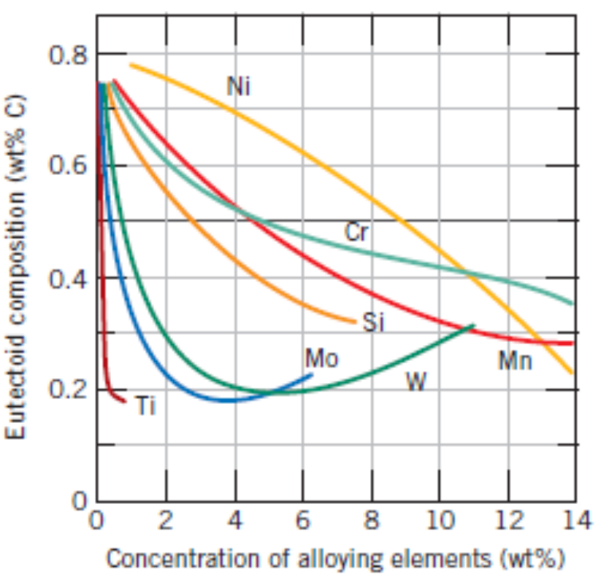
Adding other alloying elements to Fe – C system

Slide 35
Concept Check?
How many kilograms of nickel must be added to 1.75 kg of copper to yield a liquidus temperature of 1300⁰C? How many kilograms of nickel must be added to 5.43 kg of copper to yield a solidus temperature of 1200⁰C?

Slide 36
Concept Check?
Consider a hypothetical eutectic phase diagram for metals A and B. Assume that: (l) α and β phases exist at the A and B extremes of the phase diagram, respectively; (2) the eutectic composition is 36 wt% A–64 wt% B; and (3) the composition of the α phase at the eutectic temperature is 88 wt% A–12 wt% B and that of β phase is 8 wt% A–92 wt% B. Melting temperatures of A and B are 327⁰C and 232⁰C. The eutectic phase transformation occurs at 183⁰C. Construct the eutectic phase diagram. Determine what composition of the alloy will yield primary β and eutectic β phase fractions of 0.367 and 0.401, respectively.

